Slide 1
Session 1: Introduction
Competitive Strategy
Luis Garicano

Slide 2
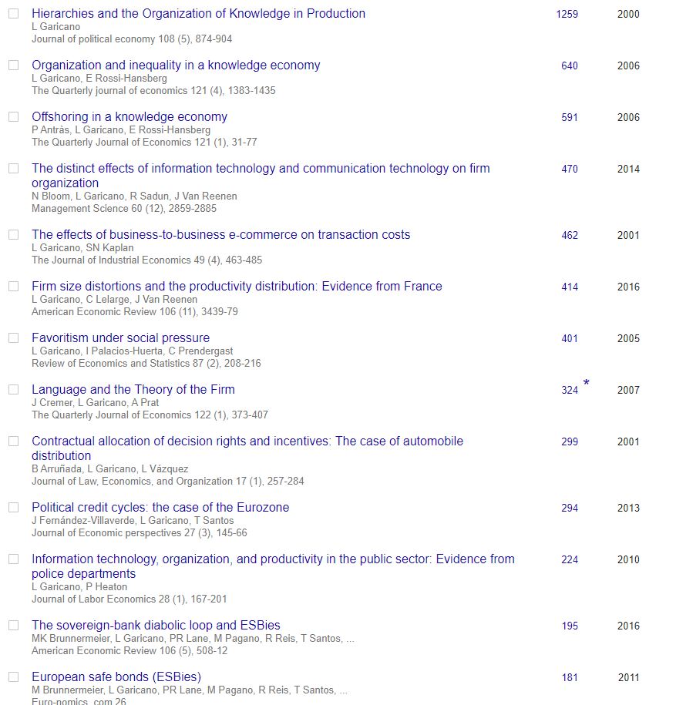
Me
1998: PhD Econ, UChicago
1998-2019:
1998-2008: Chicago Booth (Econ and Strategy) Assistant, Associate, Full (Visited MIT, LBS, UvA, UPF)
2008-2018: LSE Prof Econ and Strategy
2018, 2019: IE Business School (Econ and Strategy)
Research: Organizational economics,Strategy labor/inequality, productivity
Outside
McKinsey Chair, Fedea
Board Member, Liberbank (5th largest publicly quoted bank)
Worked with top EU electronics firm, top EU telco, top-4 software firm, start-ups (helped raise $15m)
Economists in Elected Office
Luis Garicano

Slide 3
What is strategy?
Formulation and implementation of an organization’s key market decisions
Define the organization’s goals and the methods by which they will be achieved
What activities an organization should and should not do
How
Strategic decisions:
extend across functional boundaries -- typically made by senior management
complex, ambiguous problems -- usually cannot be answered with quantitative certainty
but can learn frameworks of analysis

Slide 4
Some intellectual history
Competitive Strategy
Industrial Organization
1950s- 1960s: Not about general principles
1970s: BCG and the “experience curve”
1980: Michael Porter’s Competitive Strategy book brings SCP paradigm to strategy.
1990s: Game Theory works its way into the study of Strategy
2000s: org econ intro strategy?
1950’s- 1970’s: “Structure- Conduct- Performance” paradigm
980s: Game theory revolution in industrial organization allows for formal study of strategic interaction between firms.
1990s/ 2000s: Organizational economics

Slide 5
Grading & Requirements
Class participation 15%
Written assignments 20%
Group presentation 15%
Final 50%

Slide 6
Class Participation
Come on time! Be prepared!
Use study questions as your guide
Discuss them in study groups
Engage with your classmates. Debate one another – build on each other
DO NOT jump in with points that are not open
Guideline: 2 times with reasonable quality will do for full grade on participation; better quality may help determine ties in grades

Slide 7
4 Case Memos
Focus on the Assignment Question
May be done in groups

Slide 8
Group presentations
Volunteer for topic (done)
Objective: apply the class concepts to a particular problem, rather than to introduce theoretical ideas or frameworks.
Key: find a nice example of the particular issue and apply the concepts in the reading and class to that example.

Slide 9
Final
Open book, within 24h period.
Will include true/false questions, medium questions, short case essay.

Slide 10
Professional Conduct
Discussing cases with students of previous sections or years, web or library research on cases; or use of previous sections notes violates rules of professional conduct
it will spoil/ interfere with discussion
– the whole point of case is to provide us with common information and to allow us common knowledge
it will greatly reduce your learning experience
– it is all about developing ability/instinct to look at a business situation and think about how it looks like
it will destroy your reputation for ethical conduct with those who find out in class
it will get you in big trouble with me!

Slide 11
Next
We begin to tackle industry analysis – key question
(1) what determines the size of pie?
(2) what determines who is capturing it?

Slide 12
Why should we know how to analyze industries?
“When an industry with a reputation for difficult economics meets a manager with a reputation for excellence, it is usually the industry that keeps its reputation intact.”
Warren Buffet
Notes:
“When an industry with a reputation for difficult economics — that would be for example, the Airline Industry — meets a manager with a reputation for excellence — that would be, for example, everyone in this room, it is usually the industry that keeps its reputation intact.”

Slide 13
Long-term Profitability of US Industries: EVA 1986-97
Industry EVA Industry EVA
Tobacco 9.4 Paper and products (1.5)
Computer software Broadcasting and
& services 5.9 publishing (1.5)
Personal care Cars & trucks (1.5) products 2.8 Healthcare services (1.7) Medical products 2.7 Machine tools, hand tools (1.7) 6.0Printing & Appliances and home
advertising (2.0) furnishings (1.9)
Food processing 2.5 Telephone equipment &
Drugs & research 0.7 services (2.1)
Beverages 0.2 Plastics & products (2.6)
Textiles (0.1) Computers & peripherals (3.1)
Fashion retailing (0.4) Electrical products (3.3)
Building materials (0.6) Aerospace & defense (3.3)
Metals (1.0) Railroads (3.4)
Telecom services (1.2) Airlines (4.1)
Discount retailing (1.2) Steel (6.4)
Semiconductors Cable television (7.2)
& components (1.3) Electronics (9.2)
Average (1.1)
Source: Hawawini et al, Strategic Management Journal (January 2003)

